Slide 1
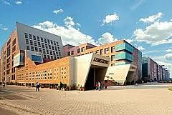
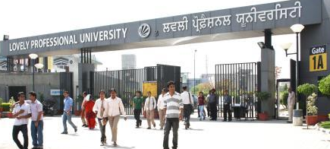
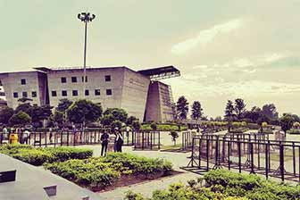
Center for Professional Enhancement

Slide 2
Mensuration
Mensuration is the branch of mathematics which deals with the study of Geometric shapes, their area, volume and related parameters.

Slide 3
Learning Outcomes
Through this Topic Candidates should be able to
understand the basic concepts of mensuration
observe the data given and interpret it from the given problem
apply the Concepts to solve Company Specific Aptitude tests
apply the Concepts to solve questions asked in various government exams like SSC CGL, Banking Sector etc.

Slide 4
Contents
2D Figures: Area, Perimeter.
3D Figures: Volume, Curved surface Area and Total surface Area.
2D Figures | 3D Figures
Rectangle | Cuboid
Square | Cube
Triangle | Cylinder
Circle | Cone
Parallelogram | Sphere
Trapezium | Hemisphere

Slide 5
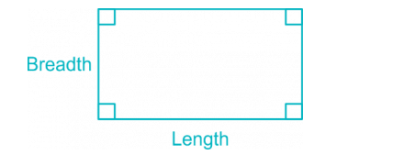
2D Figures:
Rectangle
Area of Rectangle = Length × Breadth.
Perimeter of a Rectangle = 2 × (Length + Breadth)
Length of the Diagonal = √(Length² + Breadth² )

Slide 6
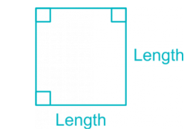
Square
Area of a Square = Length × Length = (Length)²
Perimeter of a square = 4 × Length
Length of the Diagonal = √2 × Length

Slide 7
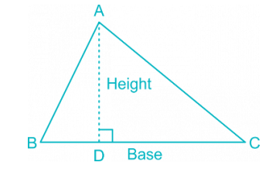

Triangle

Slide 8
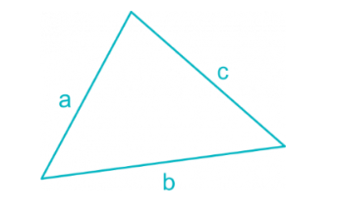
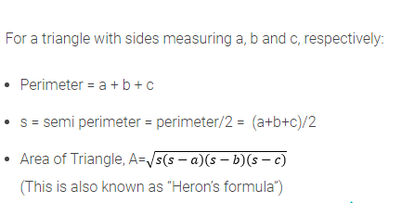
Triangle

Slide 9
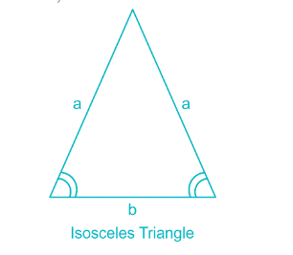

Isosceles Triangle
Area of Isosceles Triangle:
(Where a = length of two equal side, b = length of base of isosceles triangle.)

Slide 10

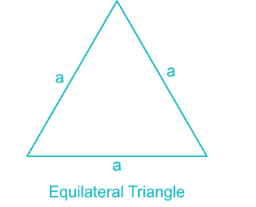
Equilateral Triangle
Area of Equilateral Triangle

Slide 11
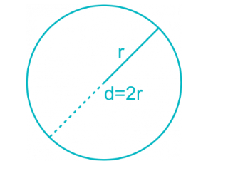
Circle & Semicircle
Area of a circle = πr² = 𝜋d²/4
Circumference of a circle = 2πr = πd
Circumference of a semicircle = πr
Area of semicircle = 𝜋r²/2
(In the following formulae, r = radius and d = diameter of the circle)

Slide 12
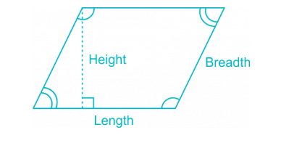
Parallelogram
Area of a Parallelogram = Length × Height
Perimeter of a Parallelogram = 2 × (Length + Breadth)

Slide 13
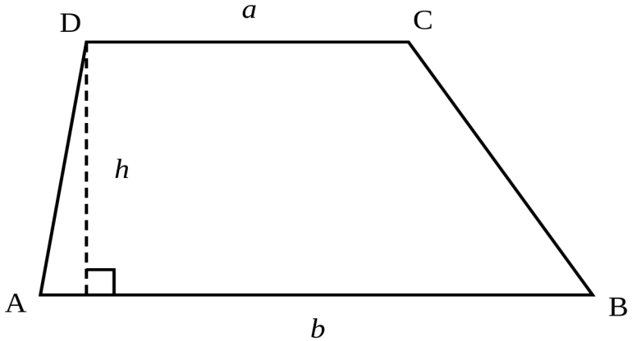
Trapezium
Area of a trapezium =(1/2)× sum of parallel sides × distance between parallel sides

Slide 14
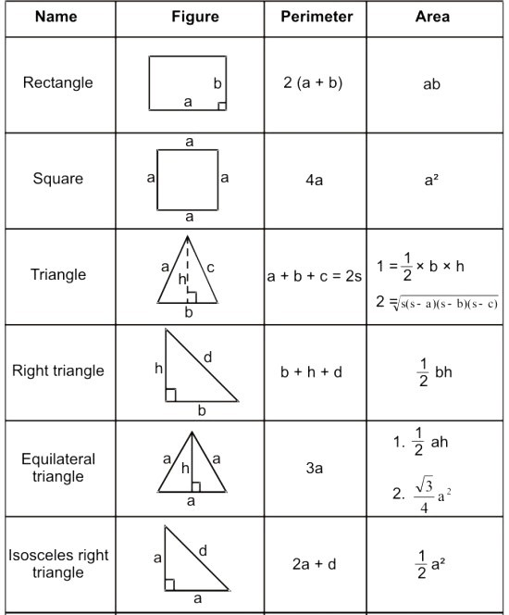

Slide 15
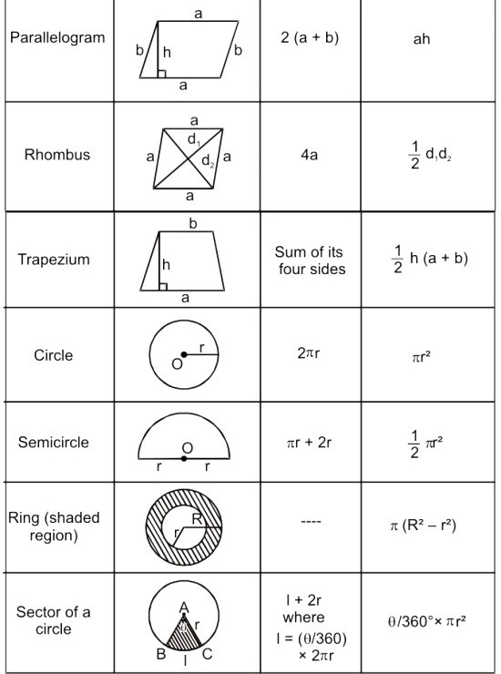

Slide 16
Practice Questions:
The area of a square is 4096 sq. cm. Find the ratio of the breadth and length of a rectangle whose length is twice the side of the square and breadth is 24 cm less than the side of the square
5:32
7:16
5:16
None of these

Slide 17
2. A wire in the form of a circle of radius 3.5 m is bent in the form of a rectangle whose length and breadth in the ratio of 6:5. What is the area of rectangle.
30
60
120
None of these

Slide 18
3. The circumference of two circles are 264 m and 352 m. Find the difference between area of the larger and smaller circles.
4123
8642
4312
2612

Slide 19
4. What would be the cost of building 7 m wide garden around a circular field with diameter equal to 280m, if the cost per sq. m for building the garden is Rs. 21
Rs. 156242
Rs. 248521
Rs. 132594
None of these

Slide 20
5. A cow is tied on the corner of a rectangular field of size 30m*20m by a 14 m long rope. The area of the region that she can graze is
350 sq. m
196 sq. m
154 sq. m
22 sq. m

Slide 21
6. At each corner of a triangular field of side 26m, 28m and 30m a cow is tethered by a rope of length 7m. The area un-grazed by the cow is
336 sq. m
259 sq. m
154 sq. m
77 sq. m

Slide 22
7. The radius of a circular field is equal to the side of a square field. If the difference between the perimeter of the circular field and that of the square field is 32m, what is the perimeter of the square field?
84m
95m
56m
28m

Slide 23
8. Two equal maximum sized circular plates are cut-off from a circular paper-sheet of circumference 352 cm. The circumference of each circular plate is.
176 cm
180 cm
165 cm
150 cm

Slide 24
9. A wire, when bent in the form of a square, encloses a region having area 121 cm2. If the same wire is bent into the form of a circle, then the area of the circle is?
144 sq. cm
180 sq. cm
154 sq. cm
176 sq. cm

Slide 25
10. The area of a triangle is 216 cm² and its sides are in the ratio 3 : 4 : 5. The perimeter of the triangle is
6 cm
12 cm
36 cm
72 cm

Slide 26
11. The ratio between the perimeter and the breadth of a rectangle is 5 : 1. If the area of the rectangle is 216 sq. cm, what is the length of the rectangle?
16
B) 18
C) 20
D) 12

Slide 27
12. Four circles having equal radii are drawn with centres at the four corners of a square. Each circle touches the other two adjacent circle. If remaining area of the square is 168 cm square, what is the size of the radius of the circle?
A. 1.4 cm
B. 14 cm
C. 35 cm
D. 21 cm

Slide 28
Mensuration- 3D

Slide 29
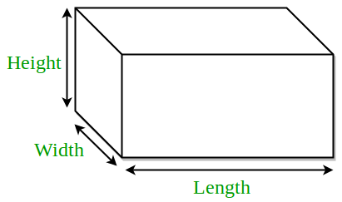
3D Figures:
Cuboid
Let
l= length
b= breadth
h= height. Then,
Volume = (l x b x h) cubic units.
Lateral Surface area = 2( b + l) h sq. units.
Surface area = 2(lb + bh + lh) sq. units.
Diagonal = √(l² + b² + h² ) units.

Slide 30
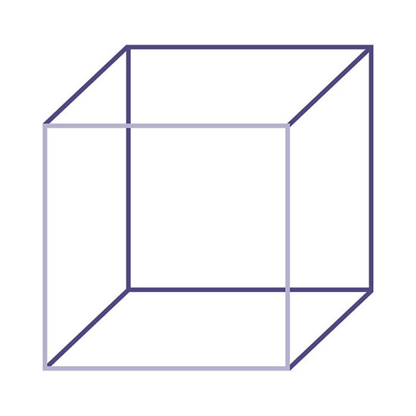
Cube
Let each edge of a cube be of length a. Then,
Volume = a³ cubic units.
Lateral Surface area = 4a² sq. units
Surface area = 6a² sq. units.
Diagonal = √3a units.

Slide 31
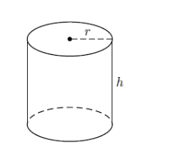
Cylinder
Let radius of base = r and Height (or length) = h. Then,
Volume = (пr²h) cubic units.
Curved surface area = (2пr h) sq. units.
Total surface area = 2 п r(h + r) sq. units.

Slide 32
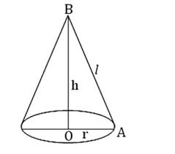
Cone
Let radius of base = r and Height = h. Then,
Slant height, l = √h² + r² units.
Volume = (1/3) п r²h cubic units.
Curved surface area = (п rl) sq. units.
Total surface area = (п rl + п r²) sq. units.

Slide 33
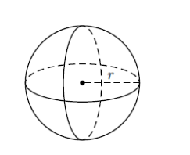
Sphere
Let the radius of the sphere be r. Then,
Volume = (4/3) п r³ cubic units.
Surface area = (4 п r²) sq. units.

Slide 34
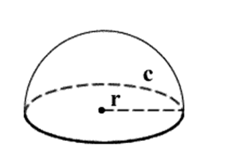
Hemisphere
Let the radius of a hemisphere be r. Then,
Volume = (2/3) п r³ cubic units.
Curved surface area = (2 п r²) sq. units.
Total surface area = (3 п r²) sq. units.

Slide 35
Practice Questions:
1. If the areas of the three adjacent faces of a cubical box are 120 cm square, 72 cm square and 60 cm square respectively, then the volume of the box is:
A. 800 cm cube
B. 680 cm cube
C. 700 cm cube
D. 720 cm cube

Slide 36
2. A wooden box measures 20 cm × 12 cm × 10 cm. the thickness of the wood is 1 cm. The volume of the wood required to make the box is:
A. 960 cm cube
B. 900 cm cube
C. 1000 cm cube
D. 1100 cm cube

Slide 37
3. The size of a wooden block is (15 cm × 12 cm × 20 cm). How many such blocks will be required to construct a solid wooden cube of minimum size?
A. 50
B. 40
C. 60
D. 55

Slide 38
4. Two solid cylinders of radii 4 cm and 5 cm and lengths 6 cm and 4 cm, respectively are recast into cylindrical disc of thickness 1 cm. The radius of the disc is
A. 7 cm
B. 14 cm
C. 21 cm
D. 28 cm

Slide 39
5. The radius of cross-section of a solid cylindrical rod of iron is 50 cm. The cylinder is melted down and formed into 6 solid spherical balls of the same radius as that of the cylinder. The length of the rod (in m) is
A. 0.8
B. 2
C. 3
D. 4

Slide 40
6. A cone, a hemisphere and a cylinder stand on equal bases of radius R and have equal heights H. Their whole surfaces are in the ratio:
A. (√3+1) : 3 : 4
B. (√2+1) : 7 : 8
C. (√2+1) : 3 : 4
D. None of these

Slide 41
7. A large solid sphere of diameter 15 m is melted and recast into several small spheres of diameter 3 m. What is the percentage increase in the surface area of the smaller spheres over that of the large sphere?
A. 200%
B. 400%
C. 500%
D. can’t be determined

Slide 42
8. A hemispherical basin 150 cm in diameter holds water one hundred and twenty times as much a cylindrical tube. If the height of the tube is 15 cm, then the diameter of the tube (in cm) is:
A. 23
B. 24
C. 25
D. 26

Slide 43
9. A cylinder is circumscribed about a hemisphere and a cone is inscribed in the cylinder so as to have its vertex at the Centre of one end and the other end as its base. The volumes of the cylinder, hemisphere and the cone are respectively in the ratio of:
A. 3 : √3 : 2
B. 3 : 2 : 1
C. 1 : 2 : 3
D. 2 : 3 : 1

Slide 44
10. A cuboidal block 6cm x 9cm x 12cm is cut up into an exact number of equal cubes. The least possible number of equal cubes will be
6
B) 9
C) 24
D) 30

Slide 45
11. The height of a cone is 40 cm. The cone is cut parallel to its base such that the volume of the small cone is 1/64 of the cone. Find at which height from base the cone is cut?
A. 20 cm
B. 30 cm
C. 25 cm
D. 22.5 cm

Slide 46


